Slide 1
Osher Lifelong Learning Institute, Fall 2026
Contemporary Economic Policy
University of Massachusetts, Boston
Host: Geoffrey Woglom, Director
National Economic Education Delegation

Slide 2

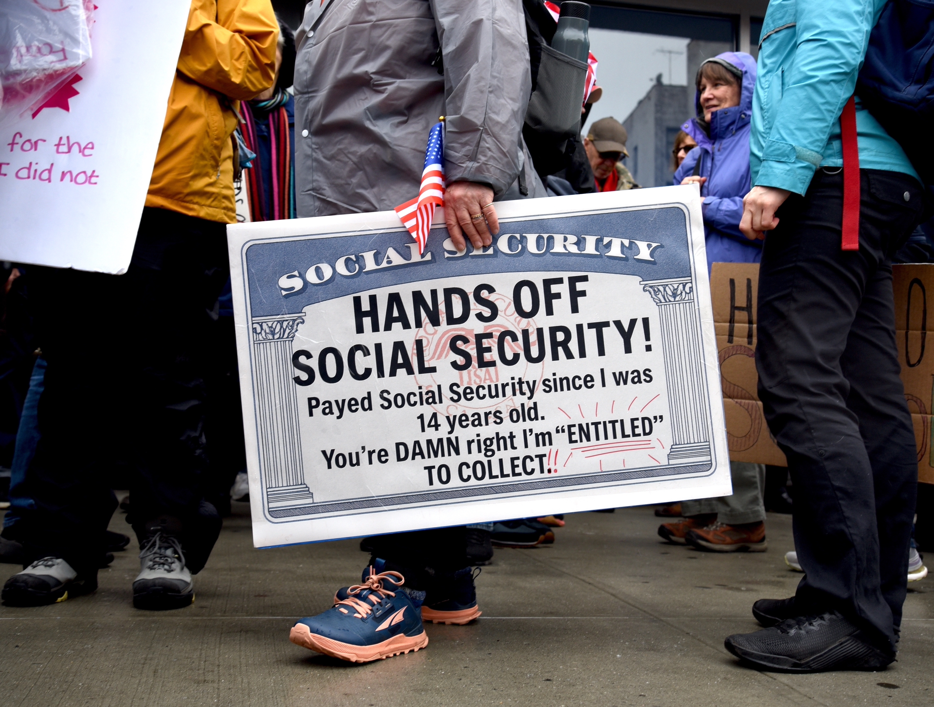
Saving Social Security
Lenox Club
September 15, 2026
Geoffrey Woglom, emeritus, Amherst College
Director, National Economic Education Delegation

Slide 3
Course Schedule
Contemporary Economic Policy
  Week 1 (9/16): Economic Update & Changes at the Fed, Geoffrey Woglom, Amherst College
  Week 2 (9/23): Economic Inequality, Joseph Carolan, Oakland University
  Week 3 (9/30): Saving Social Security, Geoffrey Woglom, Amherst College
  Week 4 (10/07): Federal Debt, Dmitriy Stolyarov, University of Michigan
  Week 5 (10/14): Trade and Globalization, Andreas Waldkirch, Colby College
  Week 6 (10/21): Climate Change Economics, Sarah Jacobson, Williams College

Slide 4
Outline
What is Social Security?
Why is Social Security in Trouble?
Closer Look at Retirement Benefits.
The Goals of Social Security and Principles for Reform
One Example of a Bipartisan Solution.

Slide 5
What is Social Security?
Social Security is a federal social insurance program that provides financial support to workers and their families.
Different benefits:
  Retirement Benefits: Social Security provides monthly payments to qualified retirees based on their lifetime earnings.
  Disability Benefits: It provides financial support to individuals who are unable to work due to a disability.
  Survivor Benefits: Social Security offers benefits to the families of deceased workers, including spouses and children.

Slide 6
Social Security’s History
“Social insurance” as part of the “social safety net”
Created in 1935 to provide economic security to the nation’s elderly (2 % payroll tax split between employer and employee).
Expanded in 1939 to include dependent benefits.
  Benefits to families that have lost a breadwinner.
First monthly check 1/31/40 to Ida May Fuller of Ludlow Vt.
Expanded in 1950 to provide support for people with disabilities.
June 1972 Congress approved a 20 percent increase in benefits and cost-of-living adjustments to start in 1975

Slide 7
Social Security’s History (cont.)
1977 Congress corrects “double-indexing mistake” that threatened SS solvency (first benefit reduction)
1983 Greenspan Commission: up to 50% of benefits of high earners subject to income taxation, gradual increase in normal retirement age, increase in payroll tax rate.
1993 85% of benefits subject to income tax for higher earners.
Today, it is the largest federal program. In FY 2025, spending was $1.58 trillion, or 22.4% of total federal spending.
  By comparison, national defense was $917 billion.

Slide 8
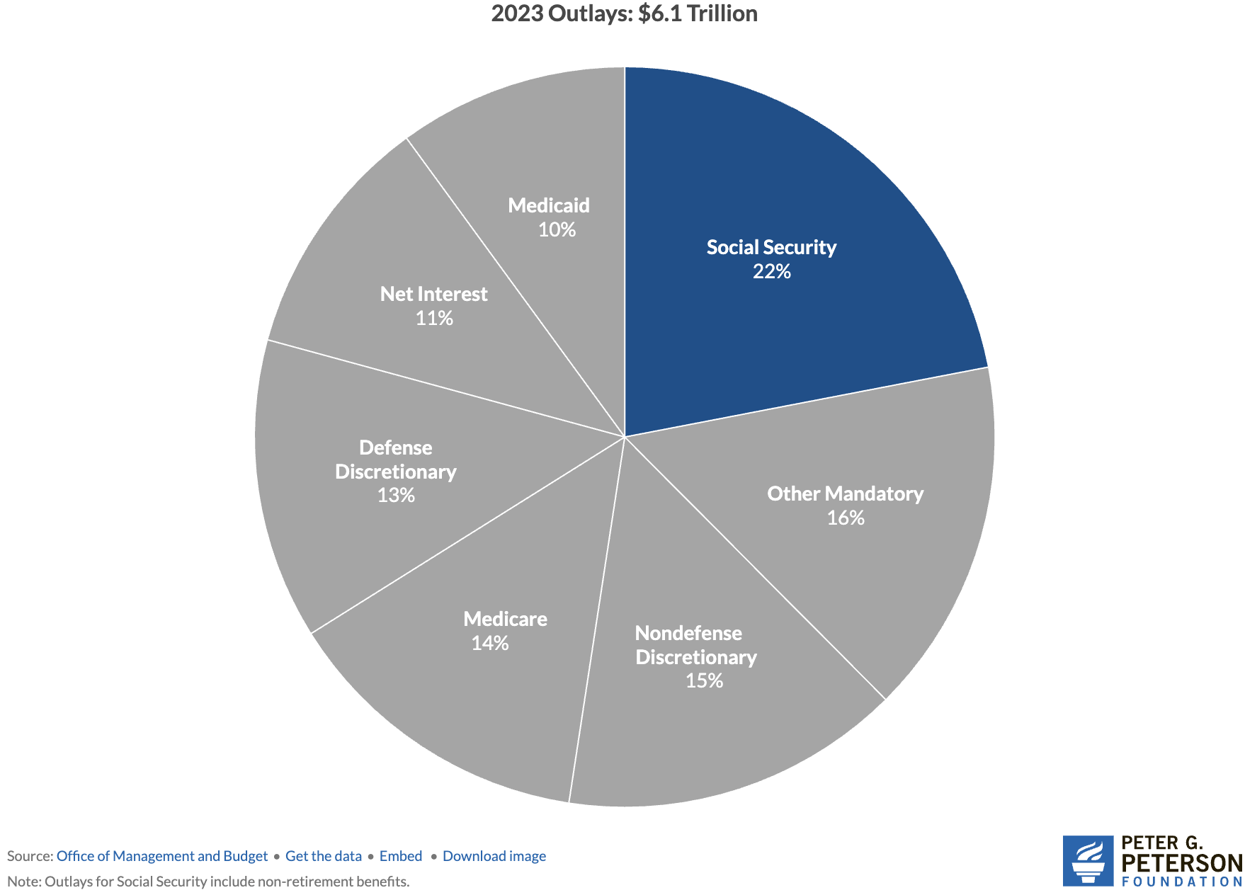
Soc Sec is The Single Largest Gov’t Program
Source: https://www.pgpf.org/article/9-facts-about-social-security-and-the-need-to-strengthen-it/

Slide 9
The Mechanics of Social Security
“pay-as-you-go” system
  Revenues come from: Payroll taxes on workers and employers, and income taxes on some social security benefits.
  Revenues pay the benefits of the currently retired, or otherwise eligible.
Payroll taxes amount to 12.4% of earnings.
  Workers pay 6.2% of earnings as payroll taxes.
  Employers also pay 6.2% of worker’s earnings.
Earnings Cap. Not all earnings are subject to payroll taxes.
  In 2026, only the first $184,500 of earnings are taxed.
  Earnings above that level are not taxed.
Income taxes on SS Benefits:
  For lowest income, benefits are not taxable
  As income rises, a fraction of benefits become taxable up to 85% at about $50,000 of AGI (not indexed).

Slide 10
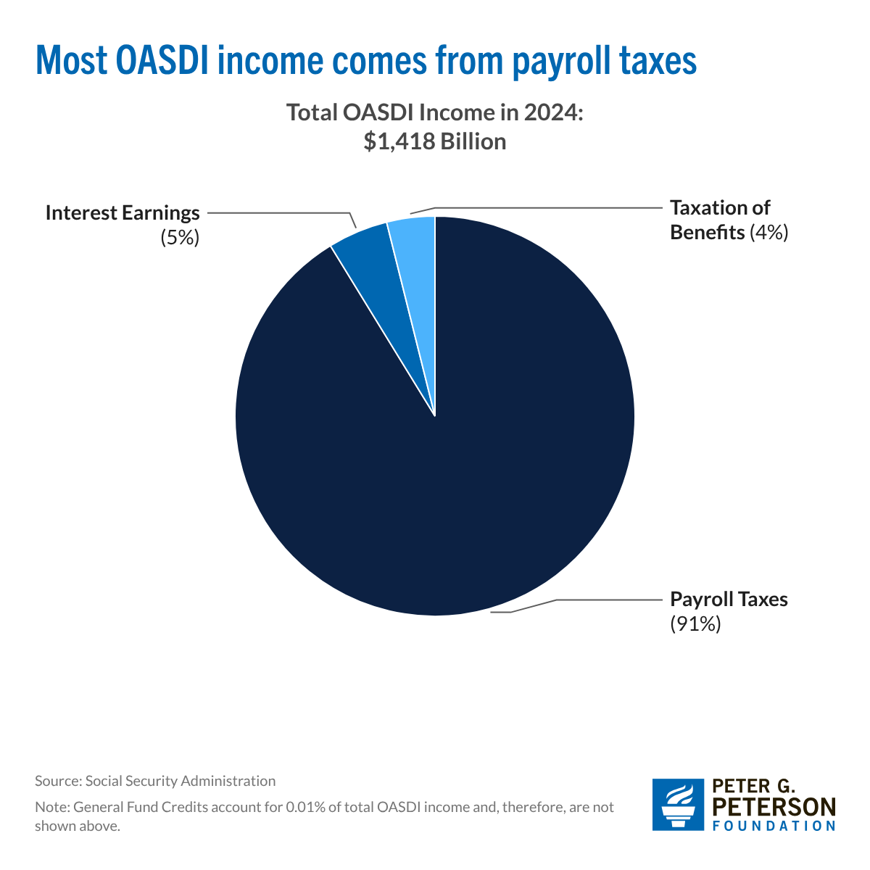
Sources of SS Revenue

Slide 11
What if SS Tax Revenues Don’t Match Benefits?
The Trust Fund
  If revenues exceed benefits, the trust fund is credited with nonmarketable government securities by the amount of the surplus.
  If benefits exceed revenues, the trust fund redeems nonmarketable securities by the amount of the deficit.
  Really just one branch of government trading Ious with another.
  The existence of the trust fund has no economic significance: The amount the government must borrow depends on total federal spending (including Social Security) less total tax revenue (including Social Security taxes).
But the existence, or lack thereof, has enormous political significance: Under current law, If the Trust fund is exhausted, Social Security benefits are limited to Social Security income.

Slide 12
Why is Social Security in Trouble?

Slide 13
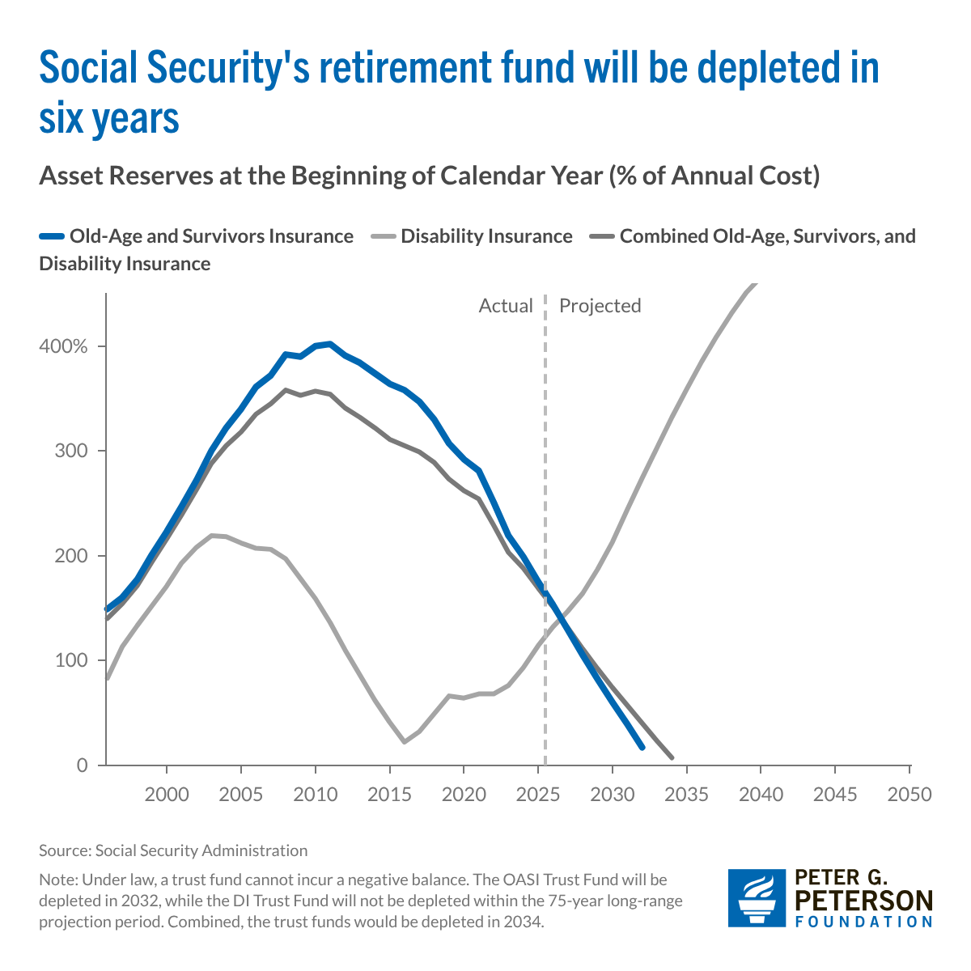
The Problem: Trust Funds are Running Out

Slide 14
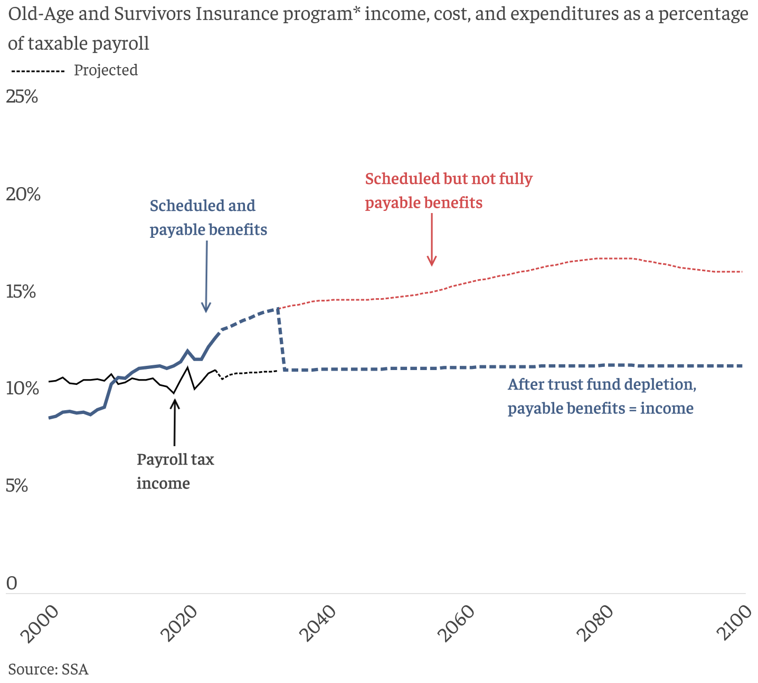
What Happens When The Trust Fund Runs Out?
OASI Trust Fund Exhaustion, 2032 Benefit Cut: 22%

Slide 15
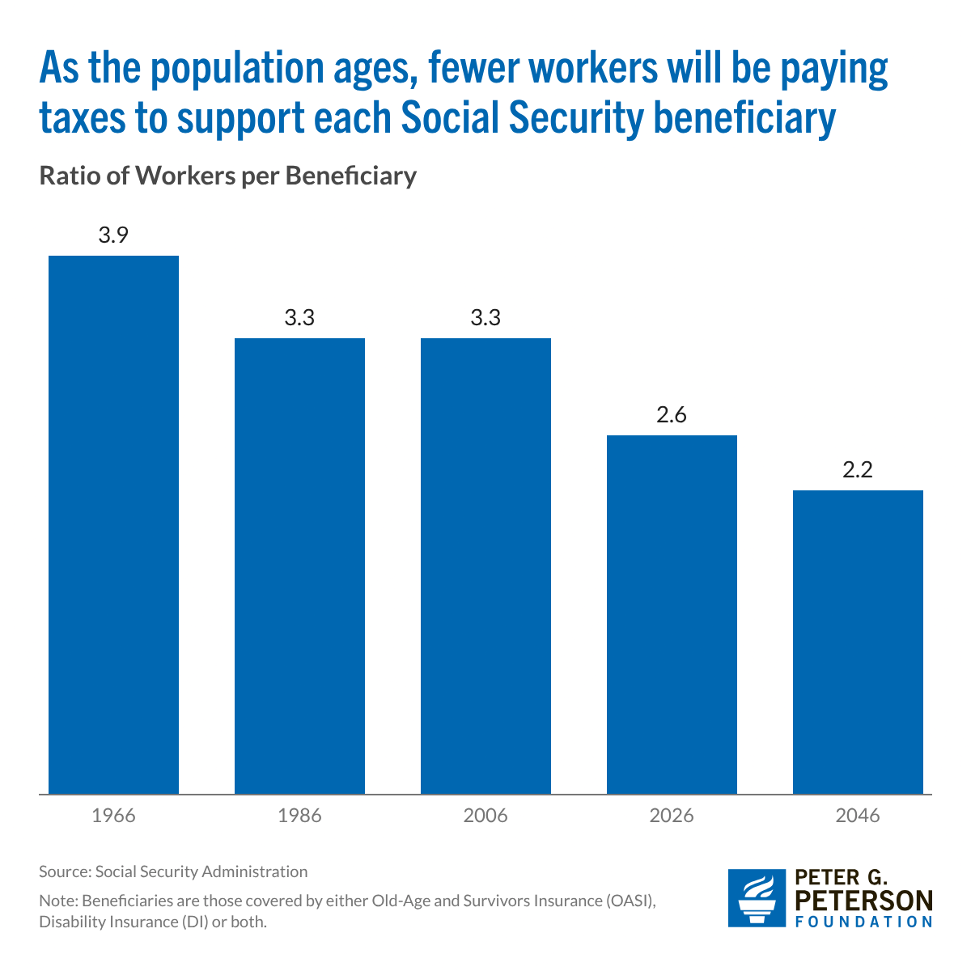
Main Problem Is Due to Aging Population
Baby Boomers are retiring.
Increasing Life Expectancy.
Baby Bust: By 2030, births = deaths.
Net immigration Way down
5. Growing wage inequality means more income is not subject to the payroll tax.
Source: https://www.pgpf.org/article/how-does-social-security-work/

Slide 16
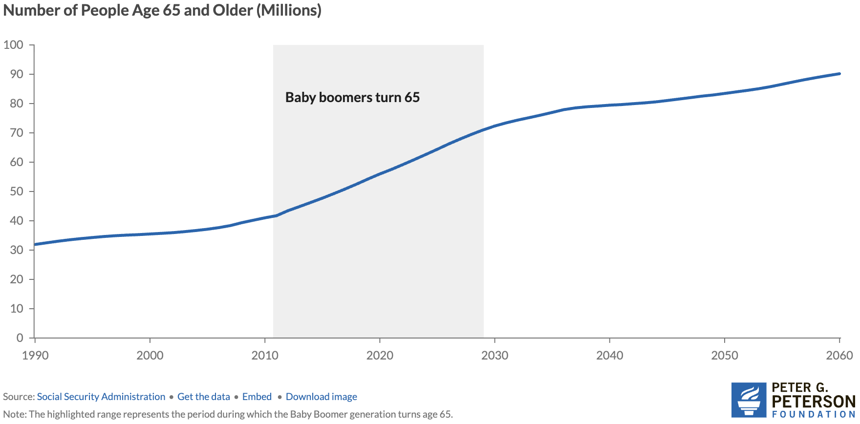
1.Why Are Costs Rising Rapidly? Aging Population
Source: https://www.pgpf.org/article/how-does-social-security-work/

Slide 17
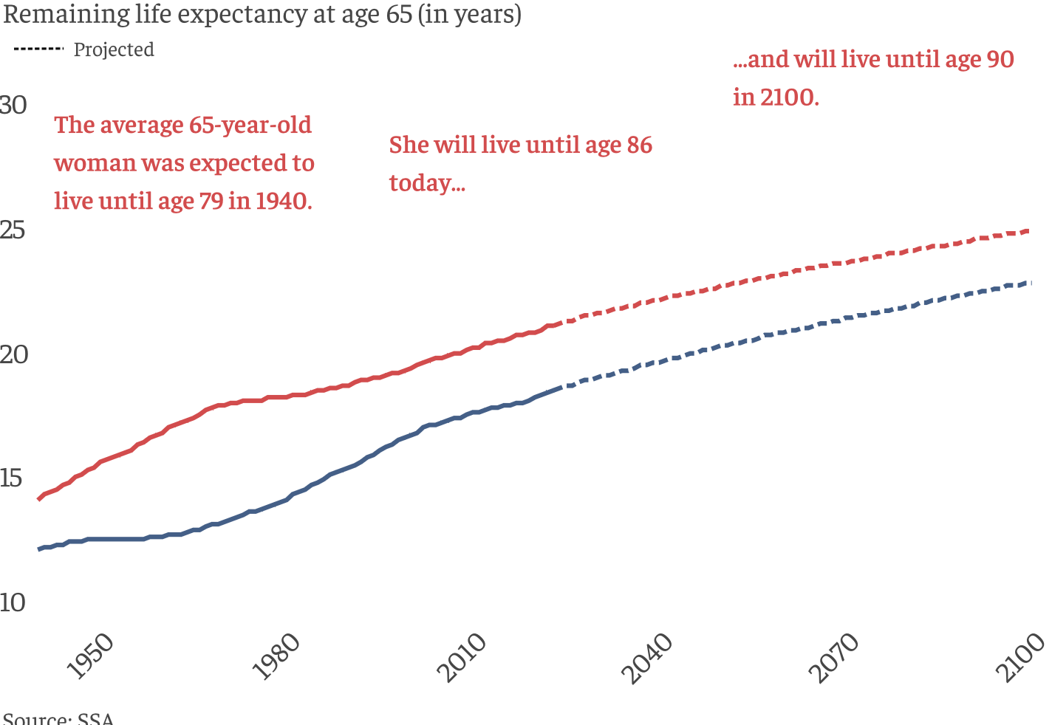
Life Expectancy Continues to Rise

Slide 18
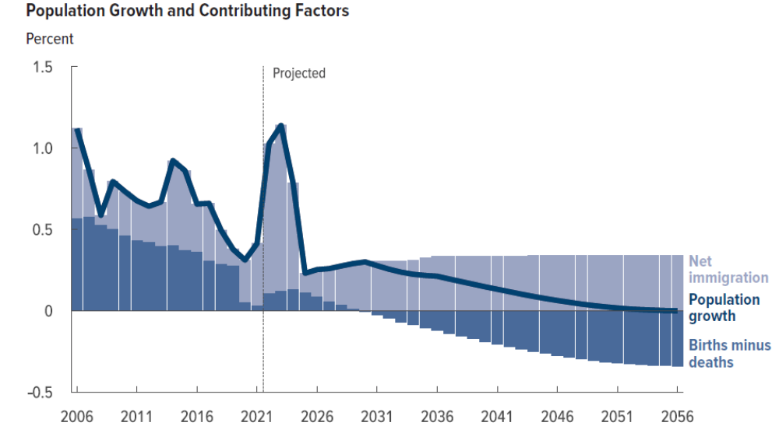
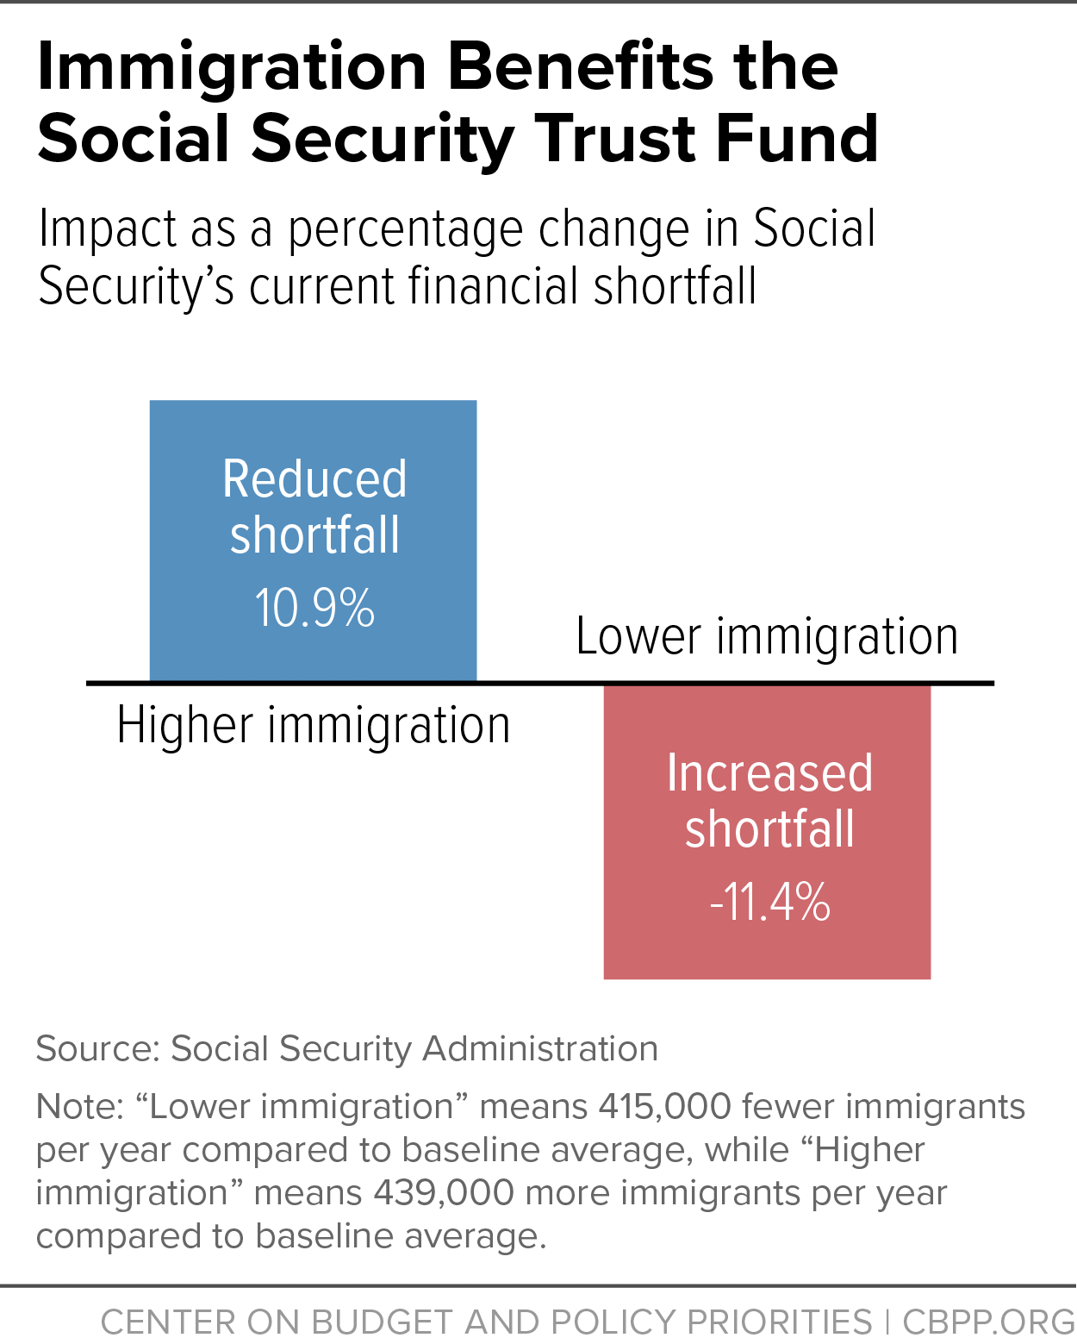
3. &4.: Future Population Growth
Note CBO (and the Social Security Trustees) are forecasting that net immigration will return to pre-Covid levels.
https://www.cbo.gov/system/files/2026-01/61879-Demographic-Outlook.pdf

Slide 19
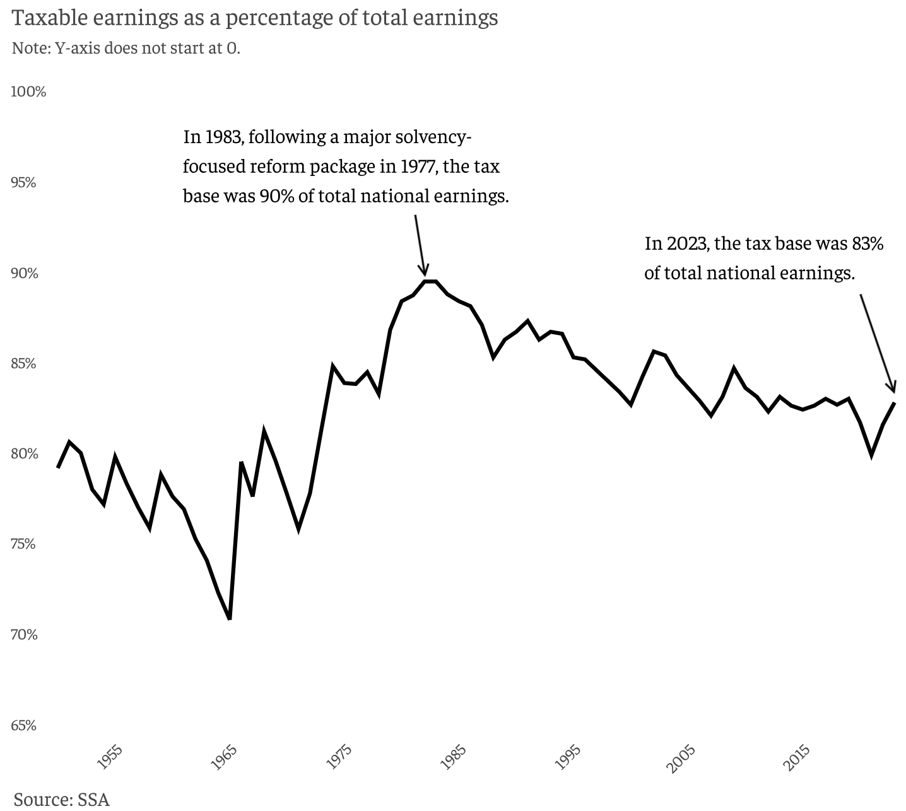
5. Tax Base is Falling

Slide 20
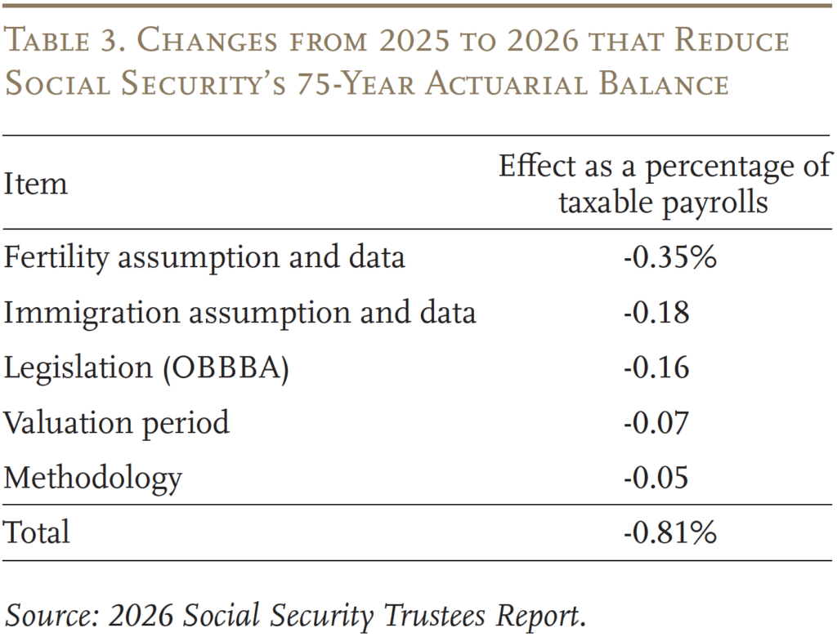
But Why Did the Depletion Date Move Up 1 Year in 2026?
These numbers reflect the deterioration of OASDI finances in the last year.
Note Items 1, 4 & 5 are not policy related.
Items 2 & 3 are policy related, and contribute 42 percent (=.34/.81) to the deterioration.
https://crr.bc.edu/social-securitys-financial-outlook-the-2026-update-in-perspective/

Slide 21
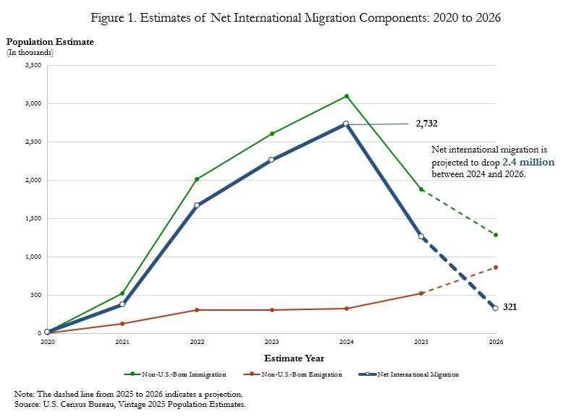
Policy Changes
One Big Beautiful Bill:
Income Tax Rates were reduced, so that the tax on Social Security benefits also fell.
In addition, the extra standard deduction of $12,000 for 65+, married filing jointly further reduced taxes collected on Social Security benefits.

Slide 22
A Closer Look at Retirement Benefits

Slide 23
Benefits are Based on Your Primary Insurance Amount (PIA)
PIA which depends on:
Your work history.
  Your average highest income over 35 years, where earlier years are indexed to wage inflation.
  Except that income for any year is “capped,” currently at $184,500
Income Cap plays two roles:
  Remember earnings above the cap are not taxed.
  But, earnings above the cap do not affect individuals’ average SS earnings.
PIA determines Retirement Benefit of a single retiree at Full Retirement age, 67

Slide 24
Benefit Formula is Highly Progressive
For every dollar average income exceeds $93K, benefits increase by 15 cents

Slide 25
Benefit Adjustments to PIA
Age when claiming
  Early: 70% at 62 to 100% at 67.
  Delayed: 108% at 68 to 124% at 70.
  Fractions designed to be (roughly, on average) actuarially fair.
Marital Status:
  Nonworking spouse adds 50% of PIA at full retirement age.
  Working spouse claims off own earnings record if it is greater.
Benefits go up each year based on CPI inflation.

Slide 26
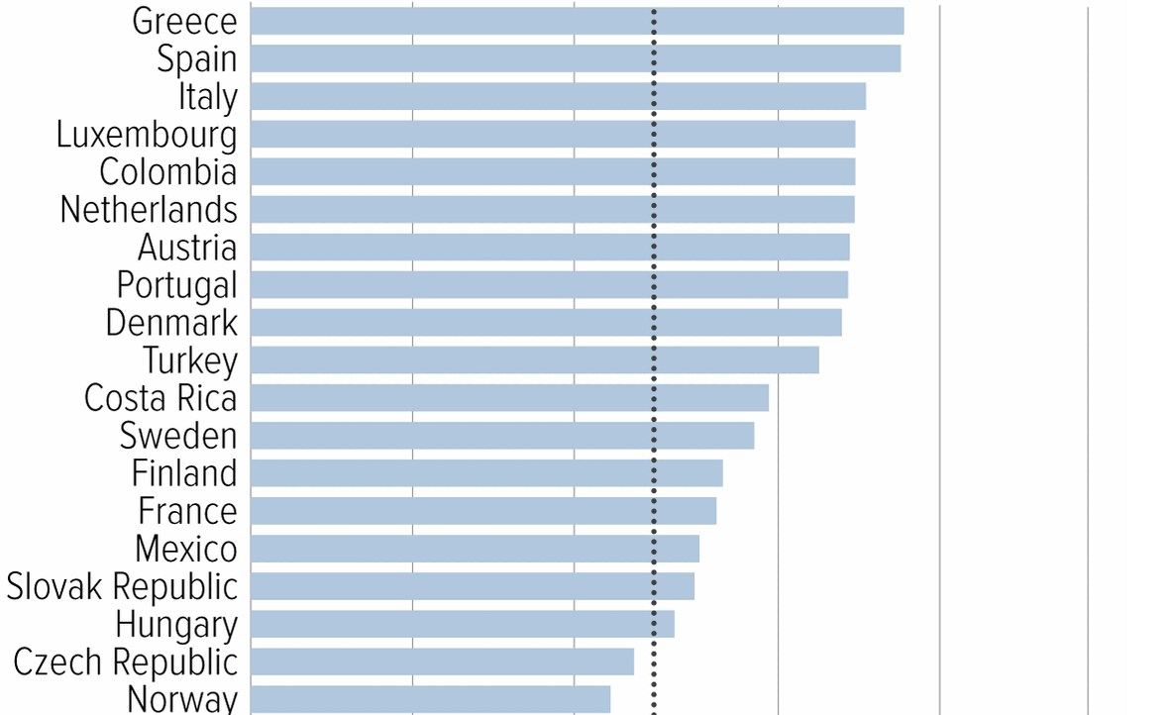
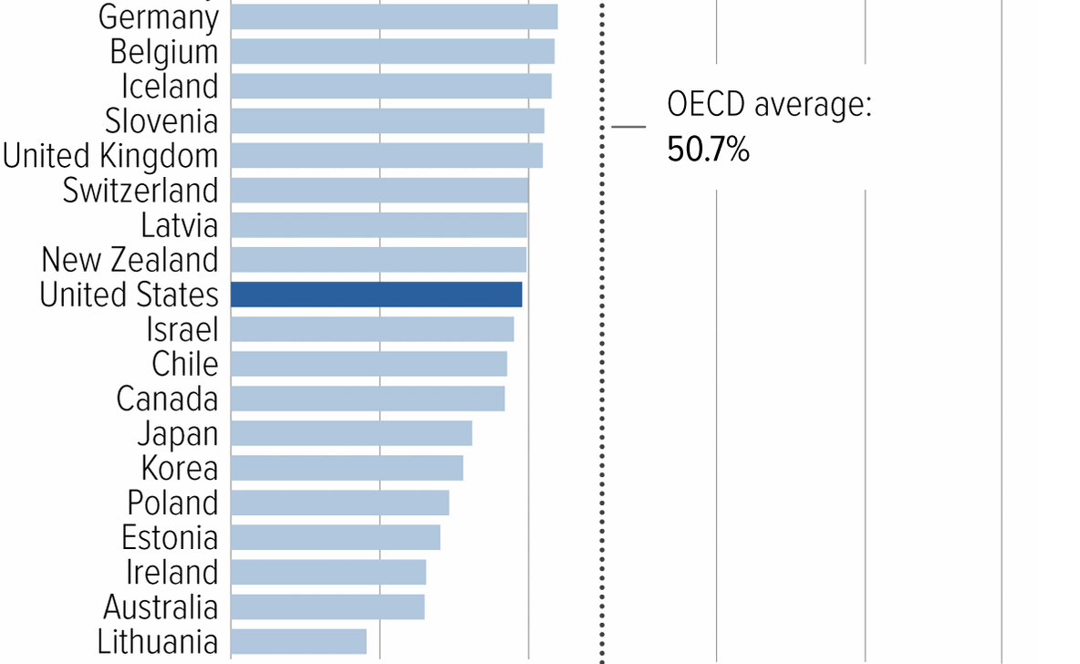
Social Security Benefits are Comparatively Low
Source: https://www.cbpp.org/research/social-security/top-ten-facts-about-social-security

Slide 27
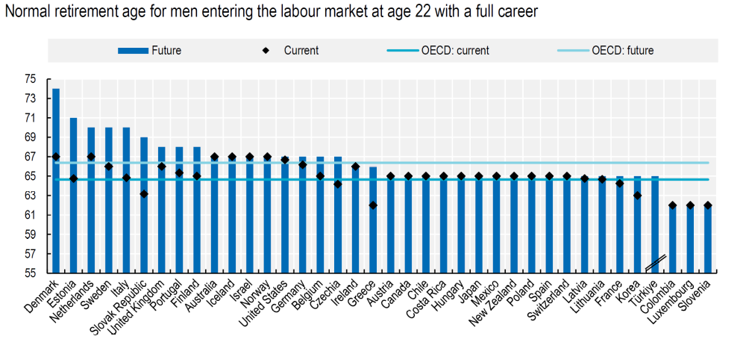
Normal Retirement Ages in the OECD
From 2025 to 2040 China’s normal retirement age for men will rise from 60 to 63; for women 55 to 58. Japan and Korea transitioning to 65.
Notes:
Poverty Rates: Korea 40%, 20% in Japan; 13% in China, and 10% in US

Slide 28
Solving the Social Security problem is simple
More revenues and/or
Reduced benefits
Why hasn’t this happened?
Politics!

Slide 29
Personal Opinion: Disingenuous & Unhelpful
Scott Bessent, Treasury Secretary at his confirmation hearings:
"These entitlements are massive. I think the next four years isn't the time to deal with them, that we've got to deal with the discretionary portion of the budget…then the next step is for a future administration to have the confidence to be able to deal with entitlements.”
Total Federal Spending last fiscal year $7 trillion: 60% Mandatory (mostly Social Security and Medicare); 27% was discretionary, and 14% was interest on the debt.
One Big Beautiful Bill and Immigration Policies are a substantial reason Social Security Finances got worse in 2025.
https://www.foxbusiness.com/politics/treasury-secretary-nominee-scott-bessents-3-3-3-plan-what-know

Slide 30
The Goals of Social Security and Principles for Reform

Slide 31
The Goals of Social Security
Not mutually exclusive goals of Social Security:
  Partial earnings replacement via forced savings.
  Social Insurance: protect workers against risks that are hard to insure privately.
  Poverty Prevention among the elderly.

Slide 32
1. SS as One Leg of the Three-Legged Stool
Why Forced Savings?
Private Pensions
  But, only 50-55 percent of private-sector workers are covered mostly by Defined Contribution Plans.
Private Savings
  But, roughly 50 percent of workers aged 55-64 have little or no private savings (does not include housing wealth).
The weaknesses of these 2 legs is worse the poorer the household. Also, both these legs are subject to investment and inflation risk.
(From 1970-2025 the S&P 500 fell by 20% or more 7 times).

Slide 33
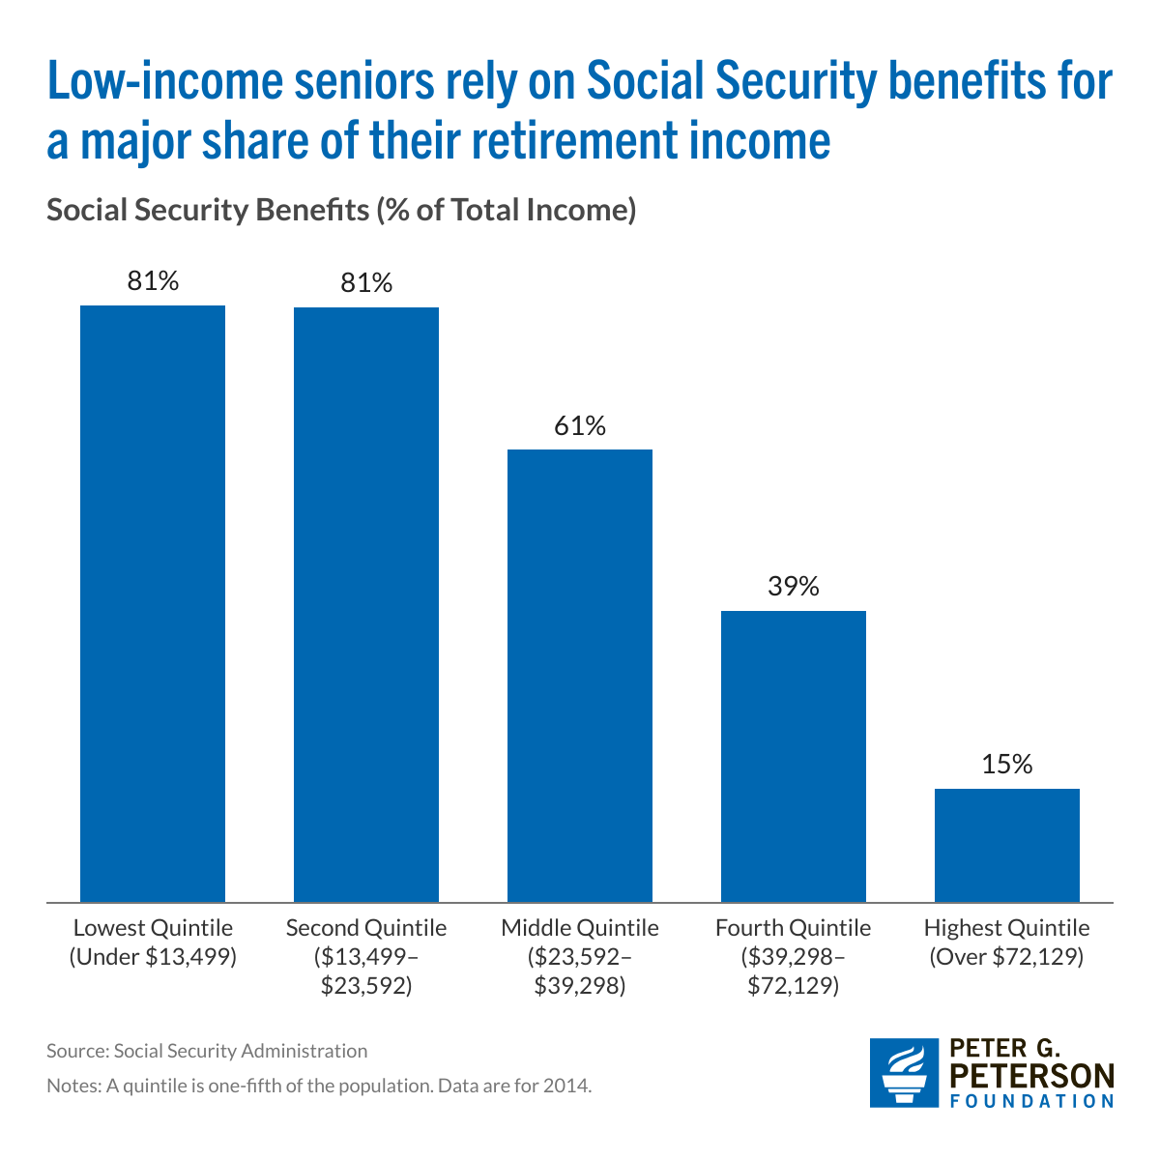
How Important Are Social Security Payments?
And Remember, Social Security is Payable for Life (Defined Benefit) and Indexed to CPI inflation

Slide 34
2. SS Insures Against Significant Risks
Protects against becoming disabled.
Protects survivors, widow(er)s and children.
Protects against outliving resources because it acts like a lifetime annuity.

Slide 35
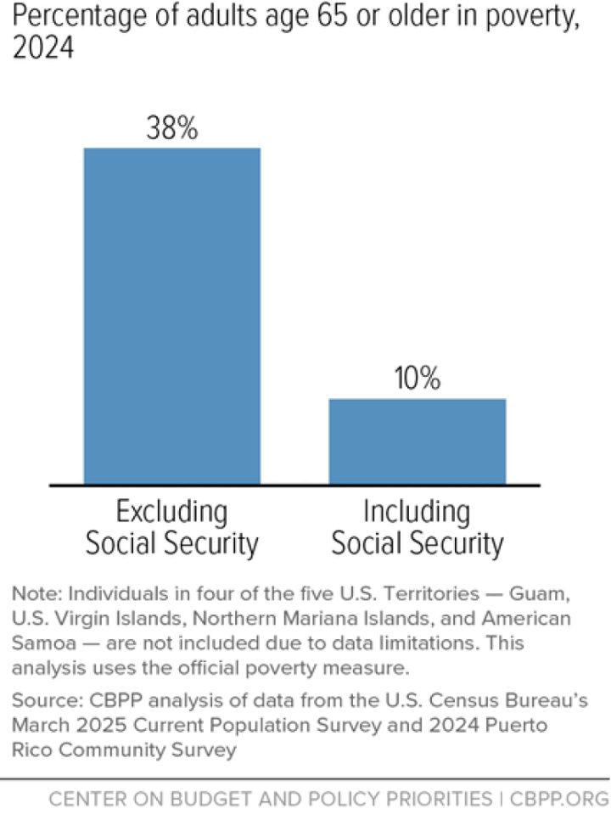
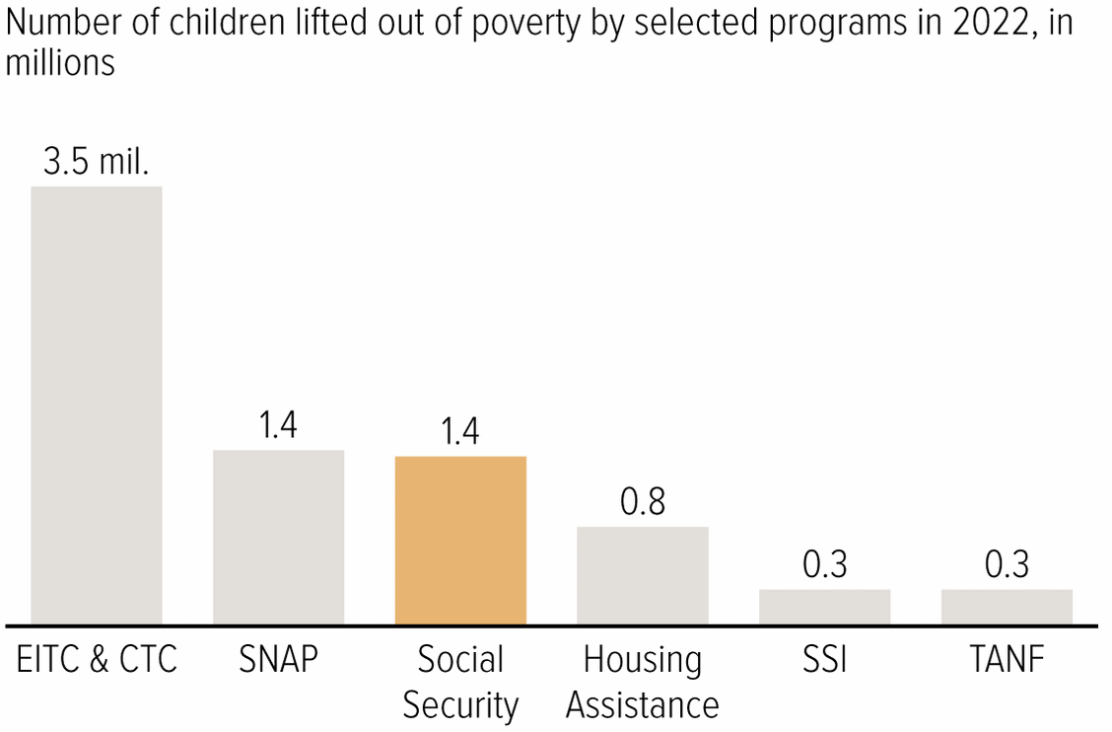
3. Soc Sec Significantly Reduces Poverty

Slide 36
Implications of 3 Different Goals
If there were only one goal (which there is not), what would be the implications for saving Social Security?
Forced Savings: Maintain a link between taxed earnings and benefits.
Social Insurance: Survivor and disability benefits are central. Progressivity in benefits is appropriate because low earners face greater risk.
Poverty Prevention: Payroll tax links to benefits is a historical artifact. Means-tested benefits. (Conflicts with 1.)

Slide 37
Brookings Principles for a Solution
Principles:
Bipartisan which means benefit cuts and tax increases.
Solvency (increase revenues and lower benefits by 4.42 % of taxable payrolls. Eliminate the “GAP”)
No benefit reduction for current recipients (?).
No general fund financing (Pay benefits from SS taxes).
Universal participation.
https://www.brookings.edu/articles/fixing-social-security-blueprint-for-a-bipartisan-solution/

Slide 38
My Interpretation of Brookings Principles
Social Security is a special program, not just poverty prevention.
  “…link between wages and benefits has been a central principle… and a foundation of its political support.”
Bipartisan: I would go further: Don’t try to fix the inequities of the federal tax system with social security reform
  Preserve the traditional view that Social Security is a different type of government program.
  SS reform is tough enough and the problem is urgent.

Slide 39
Example: Roughly Based on Brookings
Slow the benefit growth of high earners (38%, of gap removed)
Index COLA to “Chained” CPI (16%)
Phase out nonworking spouse benefit (4%)
Expand Widow(er)s Benefit to 75% of combined benefit (-3%)
Calculate PIA on a 40-year average rather than 35 (15%)
Raise earnings cap to $330,500 in 2026 to cover 90% of wages (23%)
Raise the payroll tax to 12.6% (5%)
Tax all SS Benefits for Retirees making more than $100,000. (3%)
Bipartisan because it involves benefit reductions (70%) and tax increases (31%)

Slide 40
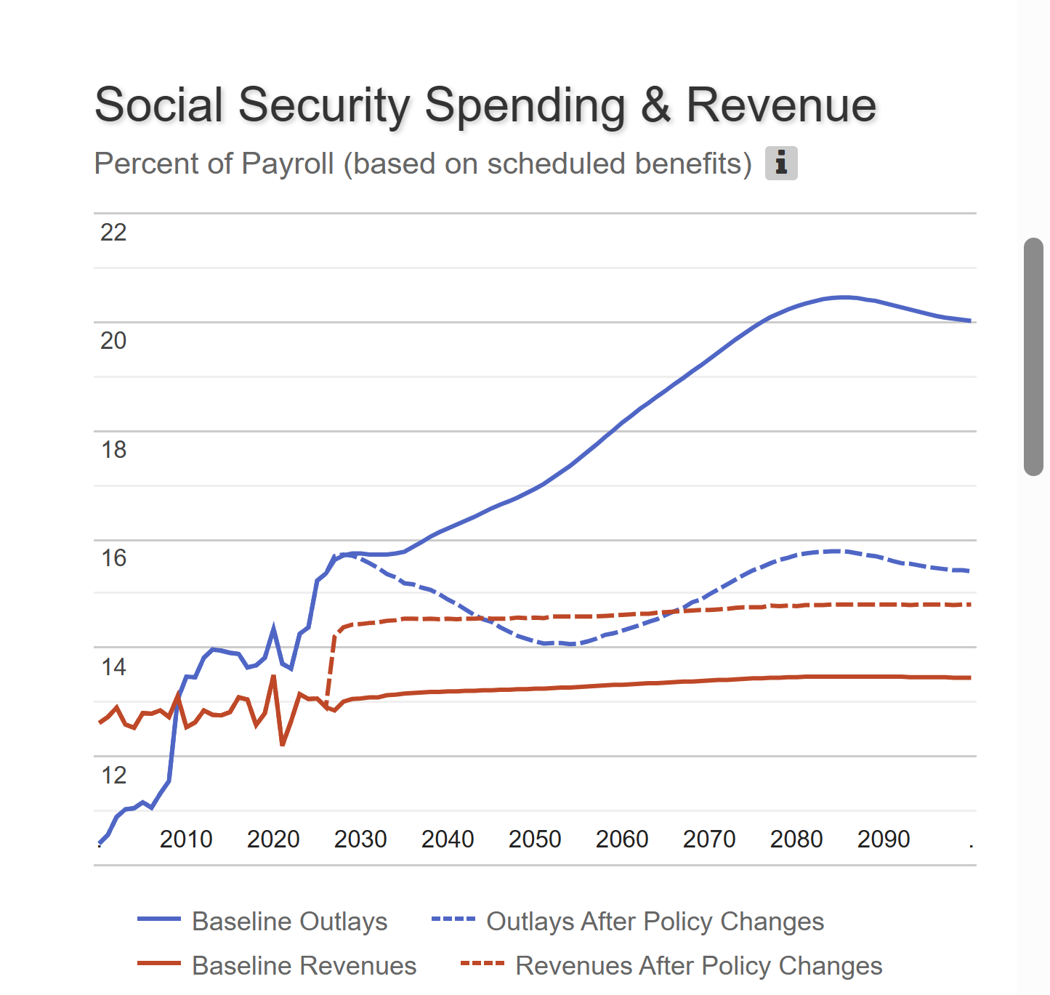
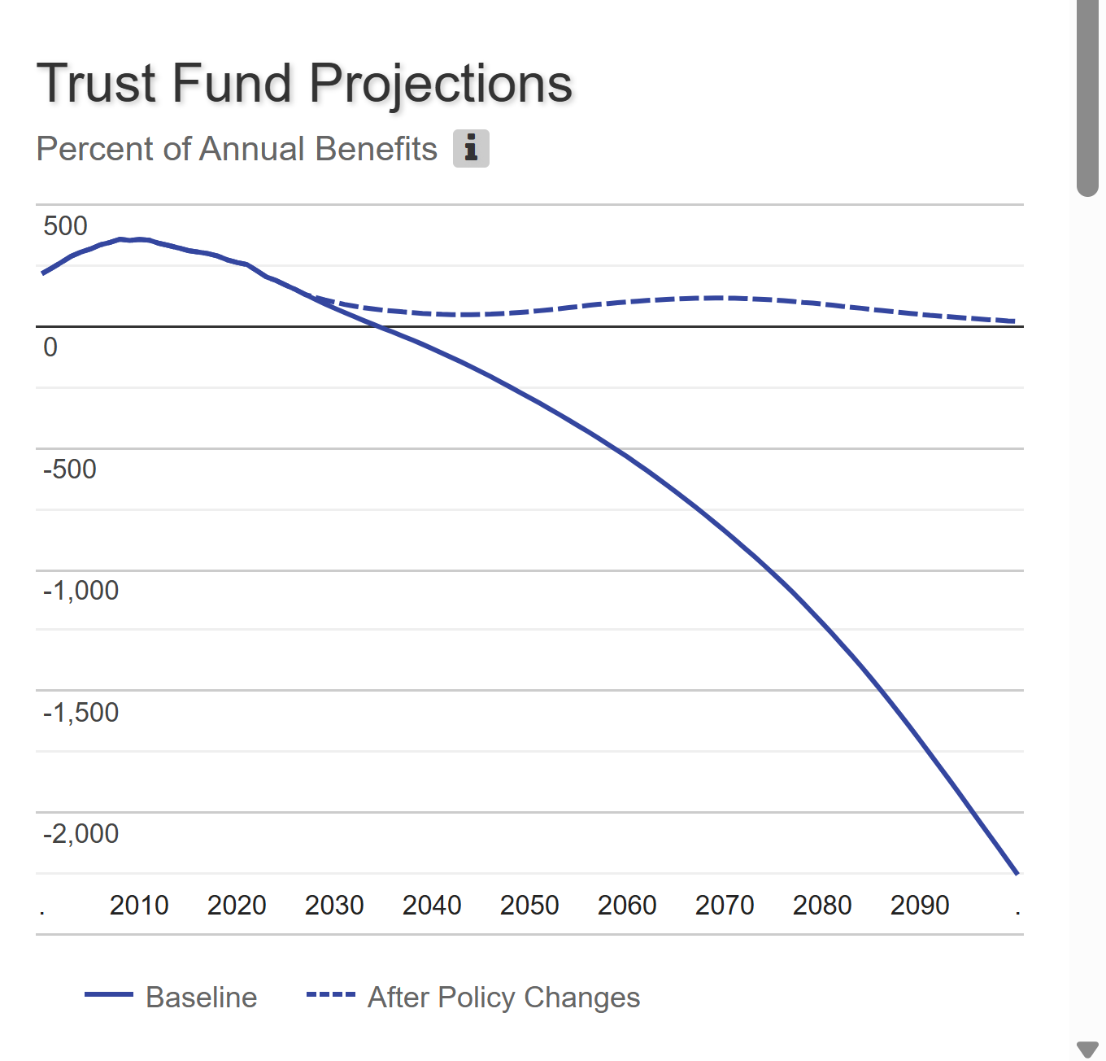

Results

Slide 41
Two Other Good Ideas from Brookings
Raise the Retirement Age for High Earners (15.5% of gap)
Expand Legal Immigration (8.5% of gap)

Slide 42
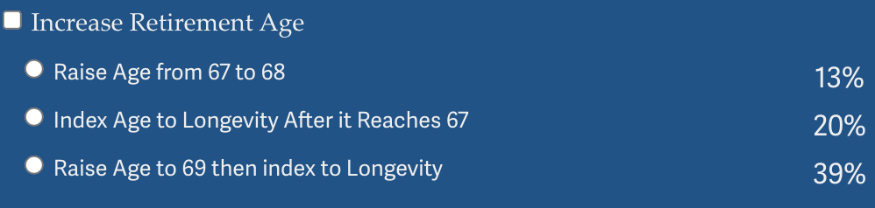
Why Not Just Raise the Retirement Age
Very regressive.
  Larger tax on low-income workers than high income workers.

Slide 43
Raising the Retirement Age
Sex | Income Category | Life Expectancy (Years) | Difference High vs Low
Women | Highest Incomes (top 1%) | 88.9 | 10.1 years
 | Lowest Incomes (bottom 1%) | 78.8
Men | Highest Incomes (top 1%) | 87.3 | 14.6 years
 | Lowest Incomes (bottom 1%) | 72.7

Slide 44
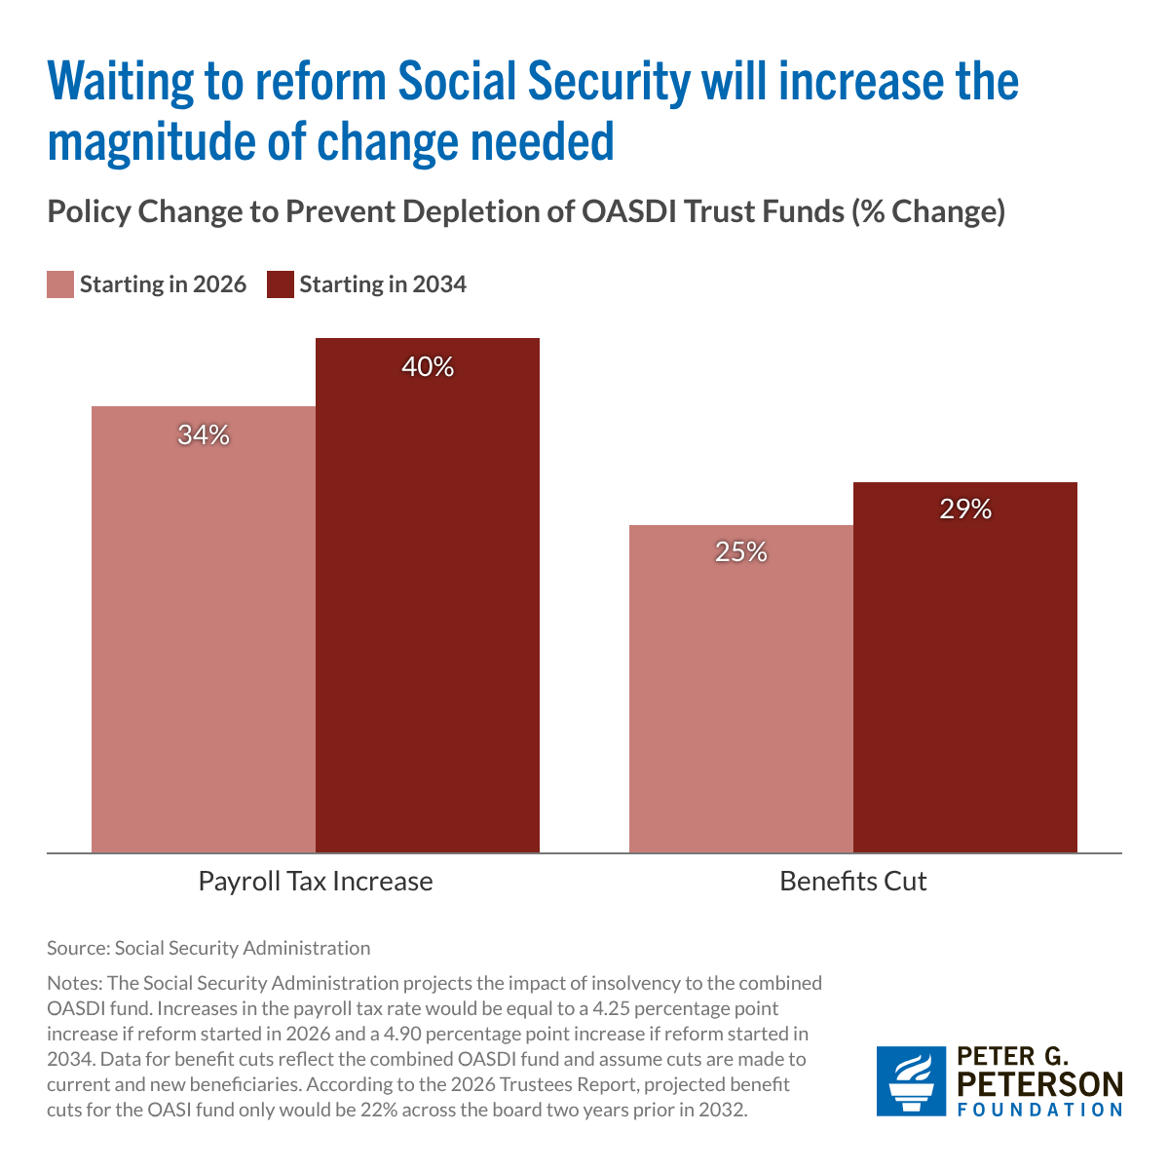
The Sooner We Act the Better
We cannot afford to let the “best” be the enemy of the “good.”

Slide 45
Should Current Retirees Share the Burden?
Current retirees have less flexibility to adjust income and spending.
That may argue for a smaller relative burden, but not zero.
Also, higher income retirees have more flexibility in adjusting spending.
My opinion, for intergenerational fairness and for social solidarity, the more affluent of our generation should bear some burden

Slide 46
Summary
Social Security is an important part of the social safety net.
The OASI Trust Fund is likely to be exhausted in 2032.
Why are the funds being depleted?
  An aging population and slower growth in the labor force.
What happens when the funds are depleted?
  Benefits may have to be reduced by 22%, but the system will continue
Solutions abound. The problem is political will.
  The needed changes will be unpopular, but they are manageable. The longer we wait the bigger the problem.
There is hope: both the Senate and House are considering different bills to form a commission to make proposals.

Slide 47
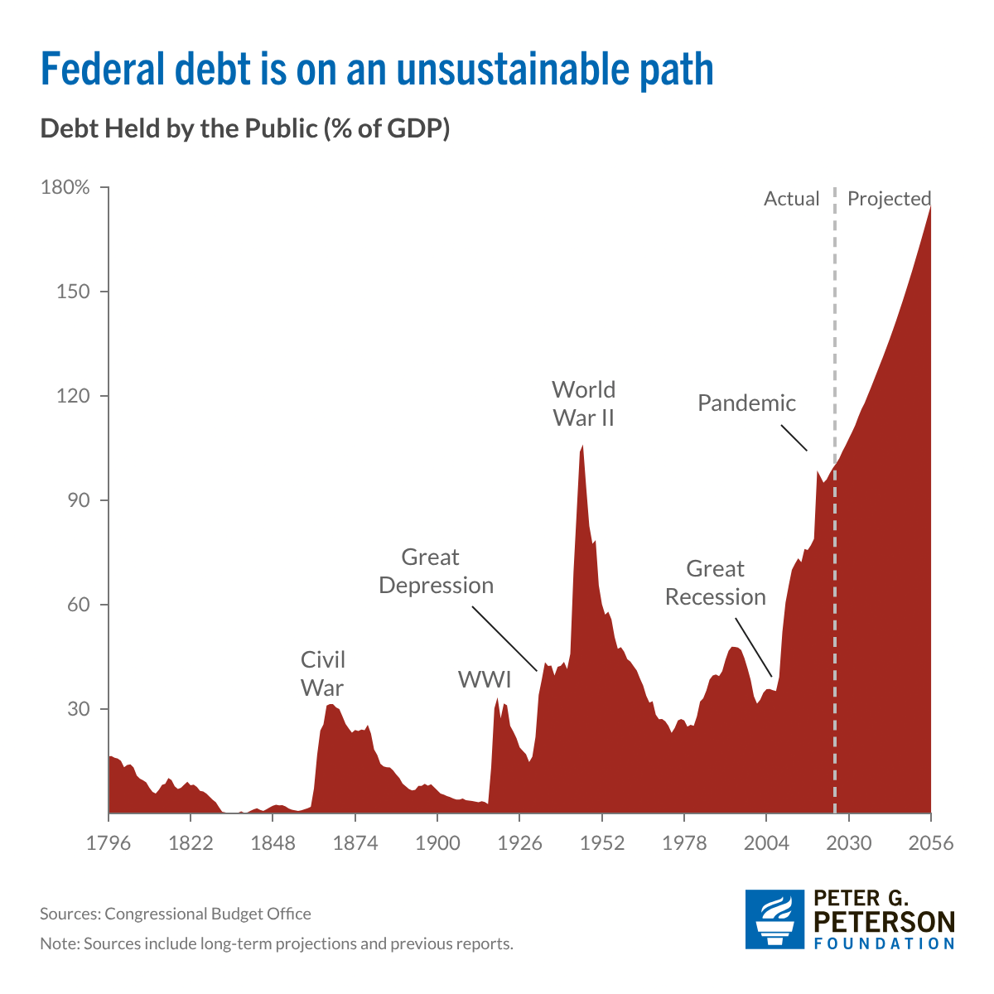
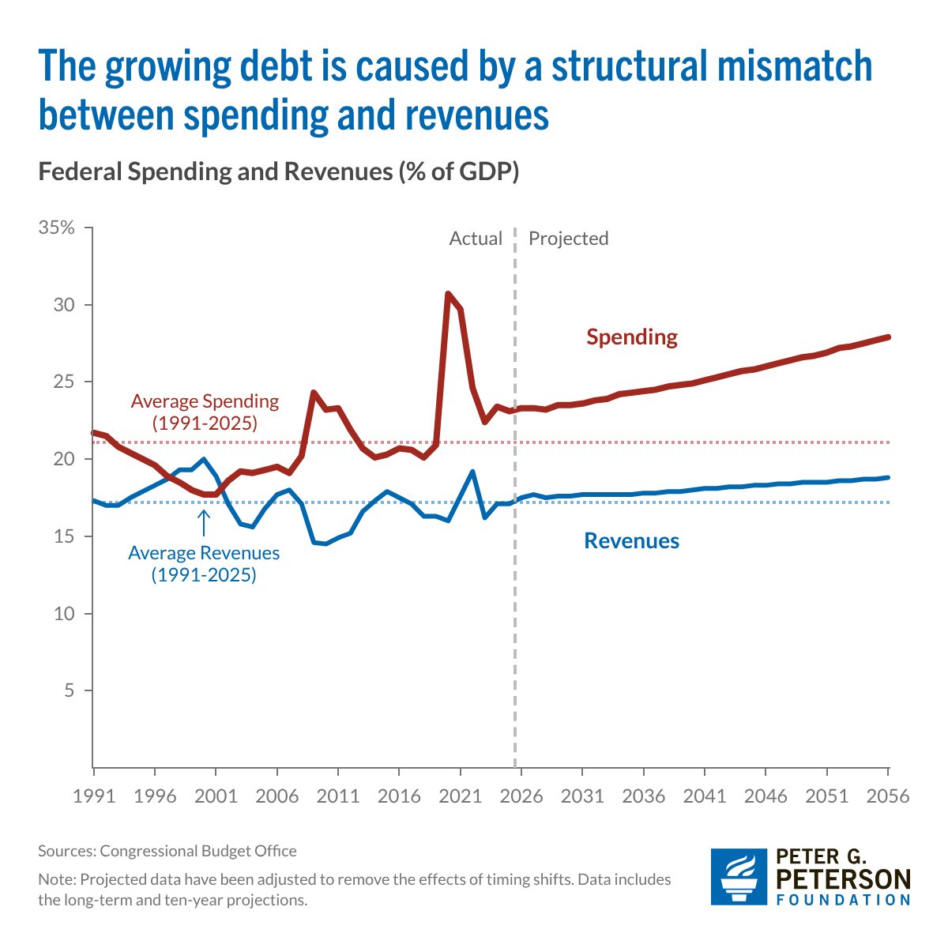
Next Week: Federal Debt & Deficits

Slide 48
Let’s Hear from You!
Geoffrey Woglom grwoglom@amherst.edu
Slides available
https://www.needecon.org/delivered_presentations.php
Additional Material
https://sites.google.com/view/macro-current-issues/social-security

